Slide 1
Error Metrics – Classification & Regression
Gowtham K Jayachandiran

Slide 2
Classification

Slide 3
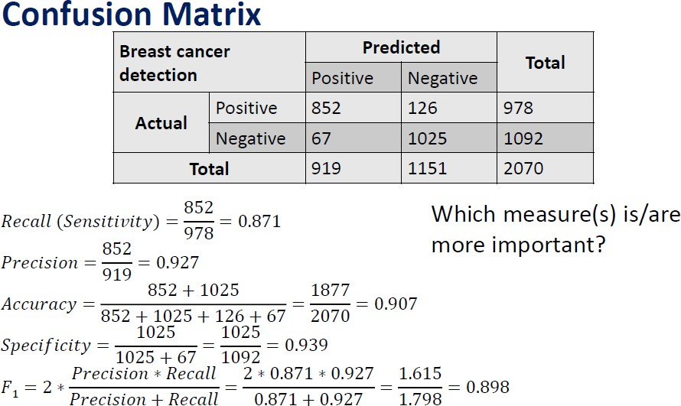

Slide 5
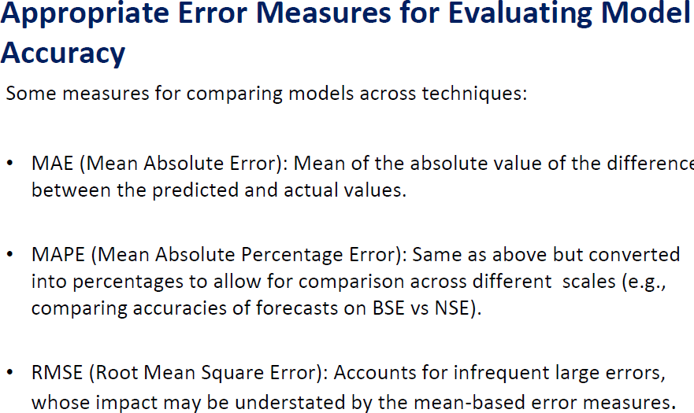
Regression

